Slide 1
A Knights duel
Group 16

Slide 2
Our Previous Idea
Tap Miner was the original idea we had.
Unfortunately due to various issues, we decided that we would be unable to achieve this game to a quality standard in the time remaining

Slide 3
Our New Idea
A Knights Duel is an advanced rock, paper, scissors strategy mechanic.
The game plays out in a turn-based RPG combat style.
The player that reduces their opponents health to 0 first is the winner.

Slide 4
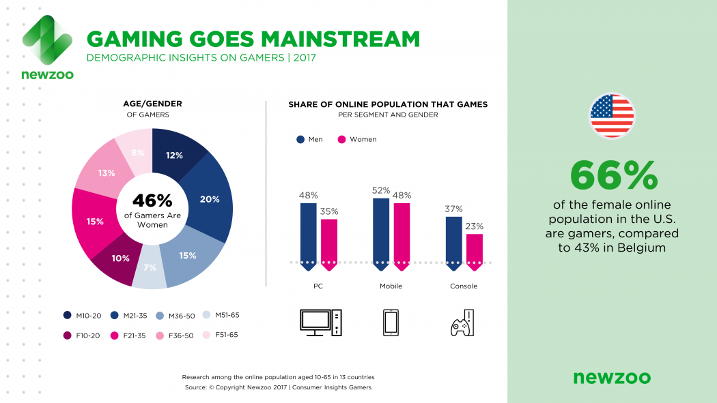
Demographic
Males
Ages 16-25
We selected this demograpic as it covers the largest part of the mobile market

Slide 5
Features
Platform: Mobile
3 moves to pick from: Standard attack, Block and Special attack.
Standard attack – beats magic attack.
Block – beats normal attack.
Special attack – beats block.

Slide 6
Features Cont.
Health bars indicate how much damage each player has taken.
Both health bars only show during the outcome of both players actions.
Each player can see their health bar during action selection.
The game utilizes hidden information via health bars.
By using widgets to stop opponents seeing how much health their opponent has remaining it challenges the player to remember how much damage they have done.
This could lead to more thoughtful/skilled play as the player can predict their opponents next move.

Slide 7
In depth mechanic explanation
A strategy mechanic utilizing advanced rock, paper, scissors.
Turn-based selections
Player 1 chooses action
Passes device to player 2
Player 2 chooses action
Places device inbetween both players
Actions resolve
Core Game Loop
Choose Action
Pass to Player 1
Pass to Player 2
Resolve
Choose Action

Slide 8
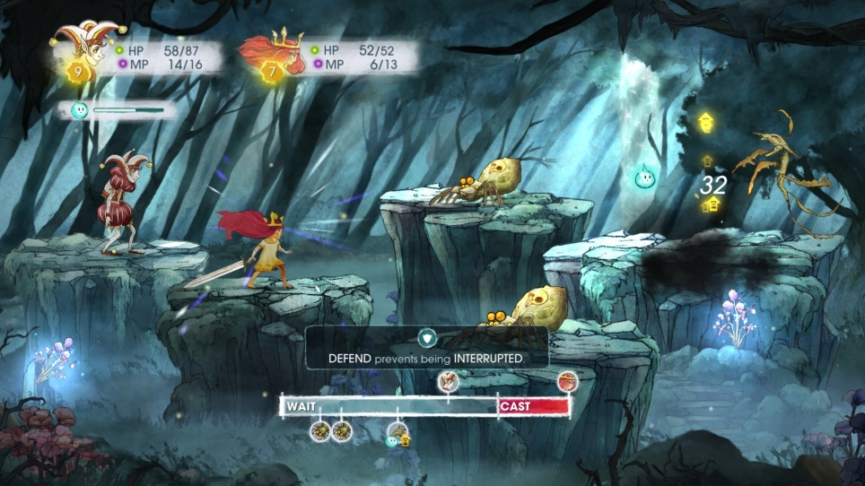
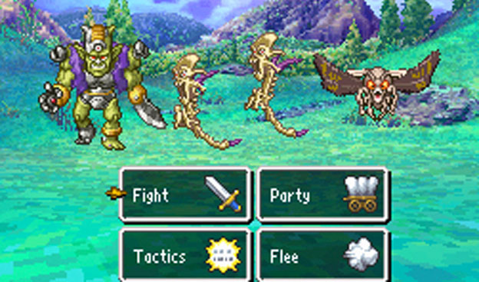
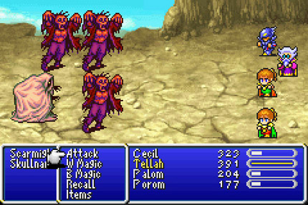
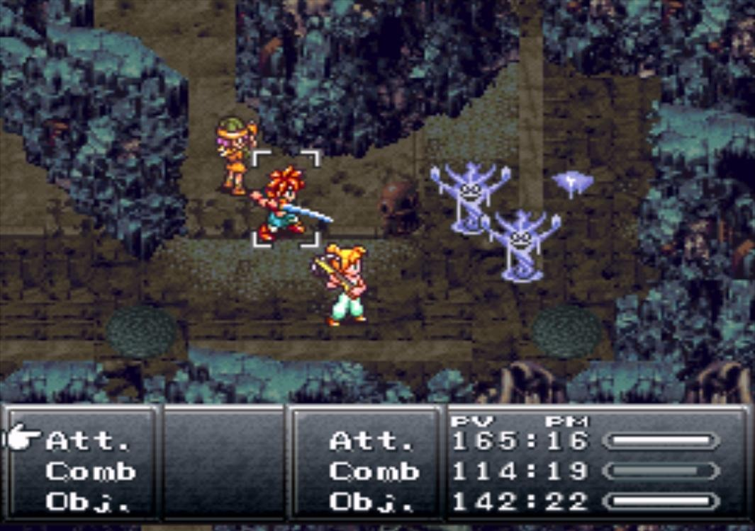
Moodboards

Slide 9
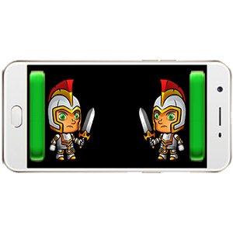
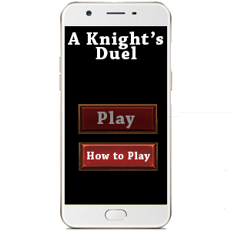
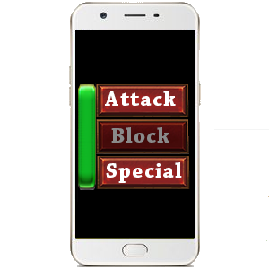
How the Game will look
Main Menu
Player Actions
Game Screen

Slide 10
Feedback
Due to aforementioned issues we have decided upon a new game, which means we haven’t had any feedback for this game yet.
Also because this idea is new we have been unable to playtest, thus today we are unable to deliver an alpha project.

Slide 11
Continuation
Over the next week, we will be;
Finishing the playable prototype
Playtesting
Questioning possible other demograpics and players
Iterating based on feedback

Slide 12
Questions?

